Slide 1


Slide 2
Module Overview
Overview of “Responsive Design”
Adjusting styles based on viewing dimensions
Adjusting styles based on device constraints
Summary

Slide 3
Rendered in that display? This changes everything!
Responsive Design

Slide 4
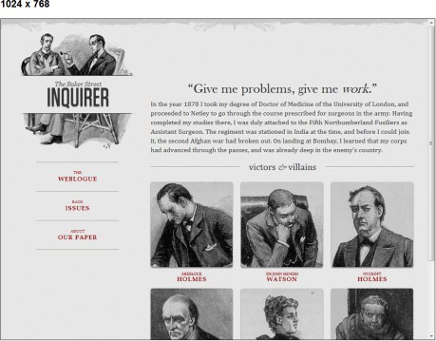


Slide 5
Resize this!
Responding to Viewing Dimensions

Slide 6
Media Queries – Viewing Area
@media screen and (max-­‐width: 600px) {
.theView { background: #dddddd;
}
}
@media screen and
(min-­‐width: 600px) and (max-­‐width: 900px) {
.theView { background: #ffffaa;
}
}

Slide 7
Oh the possibilities… (or not)
Responding to Device Constraints

Slide 8
Media Queries – Device Constraints
@media screen and (max-­‐device-­‐width: 480px) {
.theView {
background: #000000;
}
}

Slide 9
CSS3 Demos Web Site
DEMO

Slide 10
Summary
Media queries enable responsive design
Styles changed based on viewing dimensions
Styles changed based on device constraints

